Slide 1
Introduction
Traditional definition of quality:
fitness of purpose,
a quality product does exactly what the users want it to do.

Slide 2
Fitness of purpose
For software products,
fitness of purpose:
satisfaction of the requirements specified in SRS document.

Slide 3
Fitness of purpose
A satisfactory definition of quality for many products:
a car, a table fan, a food mixer, microwave oven, etc.
But, not satisfactory for software products.

Slide 4
Introduction
Consider a software product:
functionally correct,
i.e. performs all functions as specified in the SRS document,
but has an almost unusable user interface.
cannot be considered as a quality product.

Slide 5
Introduction
Another example:
a product which does everything that users want.
but has an almost incomprehensible and unmaintainable code.

Slide 6
Modern view of quality
Associates several quality factors with a software product :
Correctness
Portability
Usability
Reusability
Maintainability
Others parameters are: reliability, efficiency etc and many more as per McCall’s quality factors

Slide 7
Correctness
A software product is correct,
if different requirements as specified in the SRS document have been correctly implemented.
Accuracy of results.

Slide 8
Portability
A software product is said to be portable,
if it can be easily made to work in different operating systems,
in different machines,
with other software products, etc.

Slide 9
Reusability
A software product has good reusability,
if different modules of the product can easily be reused to develop new products.

Slide 10
Usability
A software product has good usability,
if different categories of users (i.e. both expert and naive users) can easily invoke the functions of the product.

Slide 11
Maintainability
A software product is maintainable,
if errors can be easily corrected as and when they show up,
new functions can be easily added to the product,
functionalities of the product can be easily modified, etc.

Slide 12
MCCall’s Model
-- Product operation factors: Correctness, reliability, efficiency, Integrity, Usability
-- Product revision factors: maintainability, flexibility, testability
-- Product transition factors: portability, reusability, interoperability

Slide 13
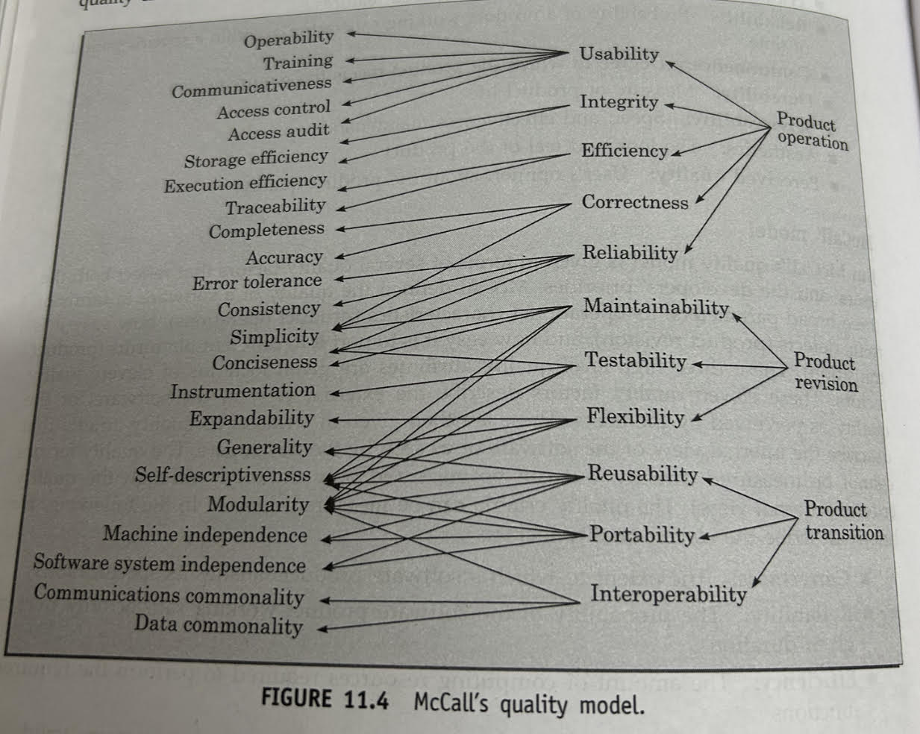

Slide 14
Software Quality Management System
Quality management system (or quality system):
principal methodology used by organizations to ensure that the products have desired quality.

Slide 15
Quality system
A quality system consists of the following:
Managerial Structure
Individual Responsibilities.
Responsibility of the organization as a whole.

Slide 16
The quality system activities encompass the following:
Auditing of projects
Collect process & product metrics and analyse them to check if quality goals are being met. Review of the quality system
Development of standard, procedures and guidelines
Production of reports for the top management summarizing the effectiveness of quality system.

Slide 17
Quality system
Every quality conscious organization has an independent quality department:
performs several quality system activities.
needs support of top management.
Without support at a high level in a company,
many employees may not take the quality system seriously.

Slide 18
Quality System Activities:
Auditing of projects
Development of:
standards, procedures, and guidelines, etc.
Production of reports for the top management
summarizing the effectiveness of the quality system in the organization.
Review of the quality system itself.

Slide 19
Quality system
A good quality system must be well documented.
Without a properly documented quality system,
application of quality procedures become ad hoc,
results in large variations in the quality of the products delivered.

Slide 20
Quality system
An undocumented quality system:
sends clear messages to the staff about the attitude of the organization towards quality assurance.
International standards such as ISO 9000 provide:
guidance on how to organize a quality system.

Slide 21
Evolution of Quality Systems
Quality systems have evolved:
over the last five decades.
Prior to World War II,
way to produce quality products:
inspect the finished products
eliminate defective products.

Slide 22
Evolution of Quality Systems
Since that time,
quality systems of organizations have undergone
four stages of evolution.

Slide 23
Evolution of Quality Systems

Slide 24
Evolution of Quality Systems
Initial product inspection method :
gave way to quality control (QC).
Quality control:
not only detect the defective products and eliminate them
but also determine the causes behind the defects.

Slide 25
Quality control (QC)
Quality control aims at correcting the causes of errors:
not just rejecting defective products.
Statistical quality control
quality of the output of the process is inferred using statistical methods
in stead of inspection or testing of all products

Slide 26
Quality control (QC)
The next breakthrough,
development of quality assurance principles

Slide 27
Quality assurance
Basic premise of modern quality assurance:
if an organization's processes are good and are followed rigorously,
the products are bound to be of good quality.

Slide 28
Quality assurance
All modern quality paradigms include:
guidance for recognizing, defining, analyzing, and improving the production process.

Slide 29
Total quality management (TQM)
Advocates:
continuous process improvements through process measurements.

Slide 30
Business Process reengineering
A term related to TQM.
Process reengineering goes a step further than quality assurance:
aims at continuous process improvement.

Slide 31
Business Process reengineering
Our focus is reengineering of the software process.
Whereas BPR aims at reengineering the way business is carried out in any organization
not just software development organizations.

Slide 32
Total quality management (TQM)
TQM goes beyond documenting processes
optimizes them through redesign.
Over the years the quality paradigm has shifted:
from product assurance to process assurance.

Slide 33
ISO 9000
ISO (International Organization for Standardization):
a consortium of 63 countries established to formulate and foster standardization.
ISO published its 9000 series of standards in 1987.

Slide 34
What is ISO 9000 Certification?
ISO 9000 certification:
serves as a reference for contract between independent parties.
The ISO 9000 standard:
specifies guidelines for maintaining a quality system.

Slide 35
What is ISO 9000 Certification?
ISO 9000 specifies:
guidelines for repeatable and high quality product development.
Also addresses organizational aspects
responsibilities, reporting, procedures, processes, and resources for implementing quality management.

Slide 36
ISO 9000
A set of guidelines for the production process.
not directly concerned about the product it self.
a series of three standards:
ISO 9001, ISO 9002, and ISO 9003.

Slide 37
ISO 9000
Based on the premise:
if a proper process is followed for production:
good quality products are bound to follow.

Slide 38
ISO 9001:
Applies to:
organizations engaged in design, development, production, and servicing of goods.
applicable to most software development organizations.

Slide 39
ISO 9002:
ISO 9002 applies to:
organizations who do not design products:
but are only involved in production.
Examples of this category of industries:
steel or car manufacturing industries
buy the product and plant designs from external sources:
only manufacture products.
not applicable to software development organizations.

Slide 40
ISO 9003
ISO 9003 applies to:
organizations involved only in installation and testing of the products.

Slide 41
ISO 9000 for Software Industry
ISO 9000 is a generic standard:
applicable to many industries,
starting from a steel manufacturing industry to a service rendering company.
Many clauses of ISO 9000 documents:
use generic terminologies
very difficult to interpret them in the context of software organizations.

Slide 42
Software vs. other industries
Very difficult to interpret many clauses for software industry:
software development is radically different from development of other products.

Slide 43
Software vs. other industries
Software is intangible
therefore difficult to control.
It is difficult to control anything that we cannot see and feel.
In contrast, in a car manufacturing unit:
we can see a product being developed through stages such as fitting engine, fitting doors, etc.
one can accurately tell about the status of the product at any time.
Software project management is an altogether different ball game.

Slide 44
Software vs. other industries
During software development:
the only raw material consumed is data.
For any other product development:
Lot of raw materials consumed
e.g. Steel industry consumes large volumes of iron ore, coal, limestone, etc.
ISO 9000 standards have many clauses corresponding to raw material control .
not relevant to software organizations.

Slide 45
Software vs. other industries
Radical differences exist between software and other product development,
difficult to interpret various clauses of the original ISO standard in the context of software industry.

Slide 46
ISO 9000 Part-3
ISO released a separate document called ISO 9000 part-3 in 1991
to help interpret the ISO standard for software industry.
At present,
official guidance is inadequate

Slide 47
Why Get ISO 9000 Certification?
Several benefits:
Confidence of customers in an organization increases
if organization qualified for ISO 9001 certification.
This is especially true in the international market.

Slide 48
Why Get ISO 9000 Certification?
Many international software development contracts insist:
development organization to have ISO 9000 certification.

Slide 49
Why Get ISO 9000 Certification?
Requires:
a well-documented software production process to be in place.
contributes to repeatable and higher quality software.
Makes development process:
focussed, efficient, and cost-effective

Slide 50
Why Get ISO 9000 Certification?
Points out the weakness of an organizations:
recommends remedial action.
Sets the basic framework:
for development of an optimal process and TQM.

Slide 51
How to Get ISO 9000 Certification?
An organization intending to obtain ISO 9000 certification:
applies to a ISO 9000 registrar for registration.
ISO 9000 registration process consists of several stages.

Slide 52
How to Get ISO 9000 Certification?
Application stage:
Applies to a registrar for registration.
Pre-assessment:
the registrar makes a rough assessment of the organization.

Slide 53
How to Get ISO 9000 Certification?
Document review and adequacy audit:
process and quality-related documents.
the registrar reviews the documents
makes suggestions for improvements.

Slide 54
How to Get ISO 9000 Certification?
Compliance audit: the registrar checks
whether the suggestions made by it during review have been complied.

Slide 55
How to Get ISO 9000 Certification?
Registration:
The registrar awards ISO 9000 certificate after successful completions of all previous phases.
Continued surveillance:
The registrar continues monitoring the organization periodically.

Slide 56
ISO 9000 Certification
An ISO certified organization
can use the certificate for corporate advertizements
cannot use the certificate to advertize products.
ISO 9000 certifies organization's process
not any product of the organization.
An organization using ISO certificate for product advertizements:
risks withdrawal of the certificate.

Slide 57
Summary of ISO 9001 Requirements
Management responsibility(4.1):
Management must have an effective quality policy.
The responsibility and authority of all those whose work affects quality:
must be defined and documented.

Slide 58
Management responsibility(4.1)
Responsibility of the quality system.
independent of the development process,
can work in an unbiased manner.
The effectiveness of the quality system:
must be periodically by audited.

Slide 59
Quality system (4.2) and contract reviews (4.3):
A quality system must be maintained and documented.
Contract reviews (4.3):
Before entering into a contract, an organization must review the contract
ensure that it is understood,
organization has the capability for carrying out its obligations.

Slide 60
Design control (4.4):
The design process must be properly controlled,
this includes controlling coding also.
A good configuration control system must be in place.

Slide 61
Design control (4.4):
Design inputs must be verified as adequate.
Design must be verified.
Design output must be of required quality.
Design changes must be controlled.

Slide 62
Document control (4.5):
Proper procedures for
document approval, issue and removal.
Document changes must be controlled.
use of some configuration management tools is necessary.

Slide 63
Purchasing (4.6):
Purchased material, including bought-in software:
must be checked for conforming to requirements.

Slide 64
Purchaser Supplied Products (4.7):
Material supplied by a purchaser,
for example,
client-provided software must be properly managed and checked.

Slide 65
Product Identification (4.8):
The product must be identifiable at all stages of the process.
In software development context this means configuration management.

Slide 66
Process Control (4.9) :
The development must be properly managed.
Quality requirements must be identified in a quality plan.

Slide 67
Inspection and Testing (4.10) :
In software terms this requires effective testing i.e.,
unit testing, integration testing and system testing.
Test records must be maintained.

Slide 68
Inspection, measuring and test equipment(4.11):
If integration, measuring, and test equipments are used,
must be properly maintained and calibrated.

Slide 69
Control of nonconforming product (4.13) :
In software terms,
keeping untested or faulty software out of released product,
or other places whether it might cause damage.

Slide 70
Corrective Action (4.14) :
This is both about correcting errors when found,
investigating why they occurred
improving the process to prevent further occurrences.
If an error reoccurs despite the quality system,
the system needs improvement.

Slide 71
Handling (4.15) and Quality audits (4.17):
Handling (4.15) Deals with:
storage, packing, and delivery of the software product.
Quality Audits (4.17) :
quality system audit must be carried out to ensure its effectiveness.

Slide 72
Training (4.18) :
Training needs must be identified and met.
Most items of ISO standard
are largely common sense.

Slide 73
Salient features of ISO 9001 requirements:
All documents concerned with the development of a software product
should be properly managed, authorized, and controlled.
Proper plans should be prepared
progress against these plans should be monitored.

Slide 74
Salient features of ISO 9001 requirements:
Important documents independently checked and reviewed:
for effectiveness and correctness.
The product should be tested :
against specification.
Several organizational aspects:
e.g., management reporting of the quality team.

Slide 75
Shortcomings of ISO 9001 Certification (1)
ISO 9000 requires a production process to be adhered to:
but does not guarantee the process to be of high quality.
Does not give any guideline for defining an appropriate process.

Slide 76
Shortcomings of ISO 9001 Certification (6)
ISO 9001 addresses mostly management aspects.
Techniques specific to software development have been ignored
Configuration management
Reviews
Release builds
Problem Notification system

Slide 77
SEI Capability Maturity Model
Developed by Software Engineering Institute (SEI) of the Carnegie Mellon University, USA:
to assist the U.S. Department of Defense (DoD) in software acquisition.
The rationale was to include:
likely contractor performance as a factor in contract awards.

Slide 78
SEI Capability Maturity Model
Major DoD contractors began CMM-based process improvement initiatives:
as they vied for DoD contracts.
SEI CMM helped organizations:
Improve quality of software they developed
Realize adoption of SEI CMM model had significant business benefits.
Other organizations adopted CMM.

Slide 79
SEI Capability Maturity Model
In simple words,
CMM is a model for apprising the software process maturity of a contractor into different levels.
Can be used to predict the most likely outcome to be expected from the next project that the organization undertakes.

Slide 80
SEI Capability Maturity Model
Can be used in two ways:
Capability evaluation
Software process assessment.

Slide 81
Capability Evaluation
Provides a way to assess the software process capability of an organization
Helps in selecting a contractor
Indicates the likely contractor performance

Slide 82
Software Process Assessment
Used by an organization to assess its current process:
Suggests ways to improve the process capability.
This type of assessment is for purely internal use.

Slide 83
SEI Capability Maturity Model
The SEI CMM classifies software development industries into:
Five maturity levels.
Stages are ordered so that improvements at one stage provide foundations for the next
Based on the pioneering work of Philip Crosby

Slide 84
SEI Capability Maturity Model
Optimizing (5)
Managed (4)
Defined (3)
Repeatable (2)
Initial (1)

Slide 85
Level 1: (Initial)
Organization operates
without any formalized process or project plans
An organization at this level is characterized by
ad hoc and often chaotic activities.

Slide 86
Level 1: (Initial)
Software production processes are not defined,
different engineers follow their own process
development efforts become chaotic.
The success of projects depend on individual efforts and heroics.

Slide 87
Level 2: (Repeatable)
Basic project management practices
tracking cost, schedule, and functionality are followed.
Size and cost estimation techniques
function point analysis, COCOMO, etc. used.
Production process is ad hoc
not formally defined
also not documented.

Slide 88
Level 3: (Defined)
Management and development activities:
defined and documented.
Common organization-wide understanding of activities, roles, and responsibilities.

Slide 89
Level 3: (Defined)
The process though defined,
process and product qualities are not measured.
ISO 9001 aims at achieving this level.

Slide 90
Level 4: (Managed)
Quantitative quality goals for products are set.
Software process and product quality metrics are collected:

Slide 91
Level 4: (Managed)
Organization sets quantitative quality goals
World-wide about 100 organizations assessed at this level.

Slide 92
Level 5: (Optimizing)
Statistics collected from process and product measurements are analyzed:
continuous process improvement based on the measurements.
Known types of defects are prevented from recurring by tuning the process
lessons learned from specific projects incorporated into the process

Slide 93
Level 5: (Optimizing)
Identify best software engineering practices and innovations:
tools, methods, or process are identified
transferred throughout the organization
World-wide about 50 organizations have been assessed at this level.

Slide 94
Key Process Areas
Each level is associated with a key process area (KPA) identifies
where an organization at the previous level must focus to reach this level

Slide 95
Level 2 KPAs
Software project planning
Size, cost, schedule.
project monitoring
Configuration management
Subcontract management

Slide 96
Level 3 KPAs
Process definition and documentation
Reviews
Training program

Slide 97
Level 4 KPAs
Quantitative measurements
Process management

Slide 98
Level 5 KPAs
Defect prevention
Technology change management
Process change management

Slide 99
Shortcomings of CMM
Focuses on what needs to improve but does not guide about how to improve.
Thicker documentations and longer meetings are required
Getting an accurate measure of an organization’s current maturity level is also an issue

Slide 100
Comparison between ISO 9001 and SEI CMM
ISO 9001 awarded by an international standards body
can be quoted in official documents and communications
SEI CMM assessment is purely for internal use.

Slide 101
Comparison between ISO 9001 and SEI CMM
SEI CMM was developed specifically for software industry:
addresses many issues specific to software industry.
SEI goes beyond quality assurance
aims for TQM
ISO 9001 correspond to SEI level 3.

Slide 102
Comparison between ISO 9001 and SEI CMM
SEI CMM provides a list of key areas
on which to focus to take an organization from one level to the other
Provides a way for gradual quality improvements over several stages.
e.g trying to implement a defined process before a repeatable process:
counterproductive as managers are overwhelmed by schedule and budget pressure.

Slide 103
CMMI
It is successor of CMM.
CMM developed from 1987-1997
In 2002, CMMI version 1.1 was released
CMMI aimed to improve the maturity models by integrating many different models into one framework
CMM versions are: SE-CMM, T-CMM, SSE-CMM, P-CMM, IPD-CMM etc.
CMMI integrated like: CMMI-SE/SW, CMMI-SE/SW/IPD etc.

Slide 104
Remarks on Quality Model Usage
Highly systematic and measured approach to software development process suits certain circumstances
negotiated software, safety-critical software, etc
What about small organizations?
Typically handle applications such as internet, e-comm.
without an established product range,
without revenue base, experience on past projects, etc.
CMM may be incompatible

Slide 105
Small Organizations
Small organizations tend to believe:
We are all competent people hired to do a job, we can’t afford training
We all communicate with one another
Osmosis works because we are so close
We are all heroes
We do what needs to be done
Therefore rules do not apply to us

Slide 106
Small Organizations
Often have problems:
Undocumented requirements
Inexperienced managers
Documenting the product
Resource allocation
Training
Peer reviews

Slide 107
Small Organizations
A two week CMM-based appraisal is probably excessive:
Small organizations need to operate more efficiently at lower levels of maturity
Must first fluorish if eventually they are to mature

Slide 108
Personal Software Process (PSP)
Based on the work of Humphrey
PSP is a scaled down version of industrial software process
suitable for individual use
Even CMM assumes that engineers use effective personal practices

Slide 109
Personal Software Process (PSP)
A process is the set of steps for doing a job
The quality and productivity of an engineer
largely determined by his process
PSP is framework that
helps software engineers to measure and improve the way they work.

Slide 110
Personal Software Process (PSP)
Helps developing personal skills and methods
Estimating and planning method
Shows how to track performance against plans
Provides a defined process
can be fine tuned by individuals
Recognizes that a process for individual use is different from that necessary for a team project.

Slide 111
Time Management
Track the way you spend time
Boring activities seem longer then actual
Interesting activities seem short
Record time for
Designing
Writing code
Compiling
Testing

Slide 112
Personal Software Process (PSP)
Planning
Design
Code
Logs
Compile
Test
Project plan summary
Postmortem

Slide 113
PSP-Planning
Problem definition
Estimate max, min, and total LOC
Determine minutes/LOC
Calculate max,min, and total development times
Enter the plan data in project plan summary form
record the planned time in Log

Slide 114
PSP-Design
Design the program
Record the design in specified format
Record the Design time in time recording log

Slide 115
PSP-Code
Implement the design
Use a standard format for code text
Record the coding time in time recording log

Slide 116
PSP-Compile
Compile the program
Fix all the defects
Record compile time in time recording log

Slide 117
PSP-Test/Postmortem
Test
Test the program
Fix all the defects found
Record testing time in time recording log
Postmortem
Compare the log data with project plan to achieve better planning in future projects to improve his process.

Slide 118
Personal Software Process (PSP)
PSP 3
• Personal process
evolution
PSP 2
• Personal quality management
• Design and code reviews
PSP 1
•Personal planning
• Time and schedule
PSP 0
• Personal measurement
• Basic size measures

Slide 119
Six Sigma
Six sigma is a quantitative approach to eliminate defects
Applicable to all types of industry - from manufacturing, product development, to service
The statistical representation of Six Sigma quantitatively describes
how a process is performing

Slide 120
Six Sigma
To achieve six sigma
a process must not produce more than 3.4 defects per million opportunities.
5 Sigma -> 230 defects per million
4 Sigma -> 6210 defects per million
Six sigma methodologies
DMAIC (Define, Measure, Analyze, Improve, Control)
DMADV: (Define, Measure, Analyze, Design, Verify)

Slide 121
Six Sigma Methodologies
The methodologies are implemented by Green belt and Black belt workers
Supervised by Master black belt worker

Slide 122
Summary
Evolution of quality system:
product inspection
quality control
quality assurance
total quality management (TQM)
Quality paradigm change:
from product to process

Slide 123
Summary
ISO 9000:
basic premise:
if a good process is followed
good products are bound to follow
provides guidelines for establishing a quality system.

Slide 124
Summary
ISO 9000
series of three standards
9001, 9002, and 9003
9001 is applicable to software industry

Slide 125
Summary
SEI CMM
developed specially for software industry
classifies software organizations into five categories.
According to the maturity of their development process.

Slide 126
Current Trends
Many organizations have already tuned their process for
Budget,
Schedule, and
Quality product.
Competition is challenging them to:
Reduce time for delivery
Adopt Six-Sigma methodology

